Slide 1
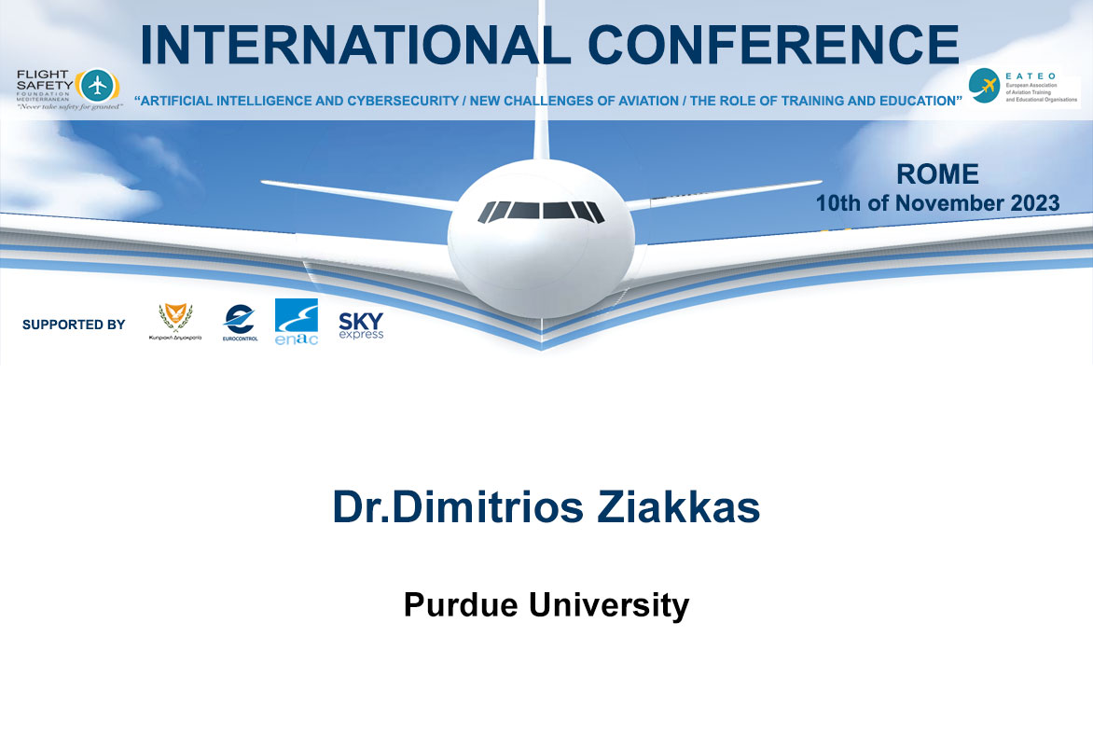

Slide 2


Implementation of Artificial Intelligence in Aviation
A Human-Centric Approach
Dr. Dimitrios Ziakkas
Assistant Professor
10 November 2023

Slide 3


What to expect
Introduction
Recent Studies
Ongoing Studies
Feedback

Slide 4
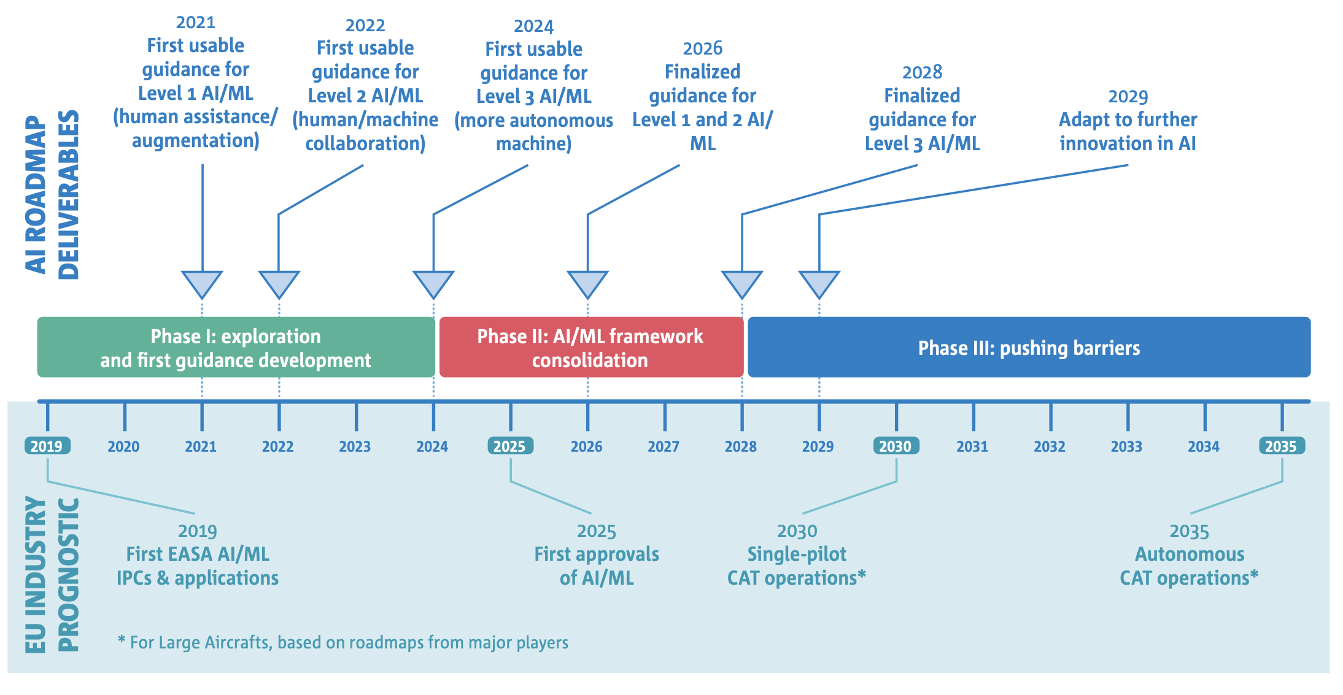
Implementation of Artificial Intelligence in Aviation
A Human-Centric Approach

Slide 5
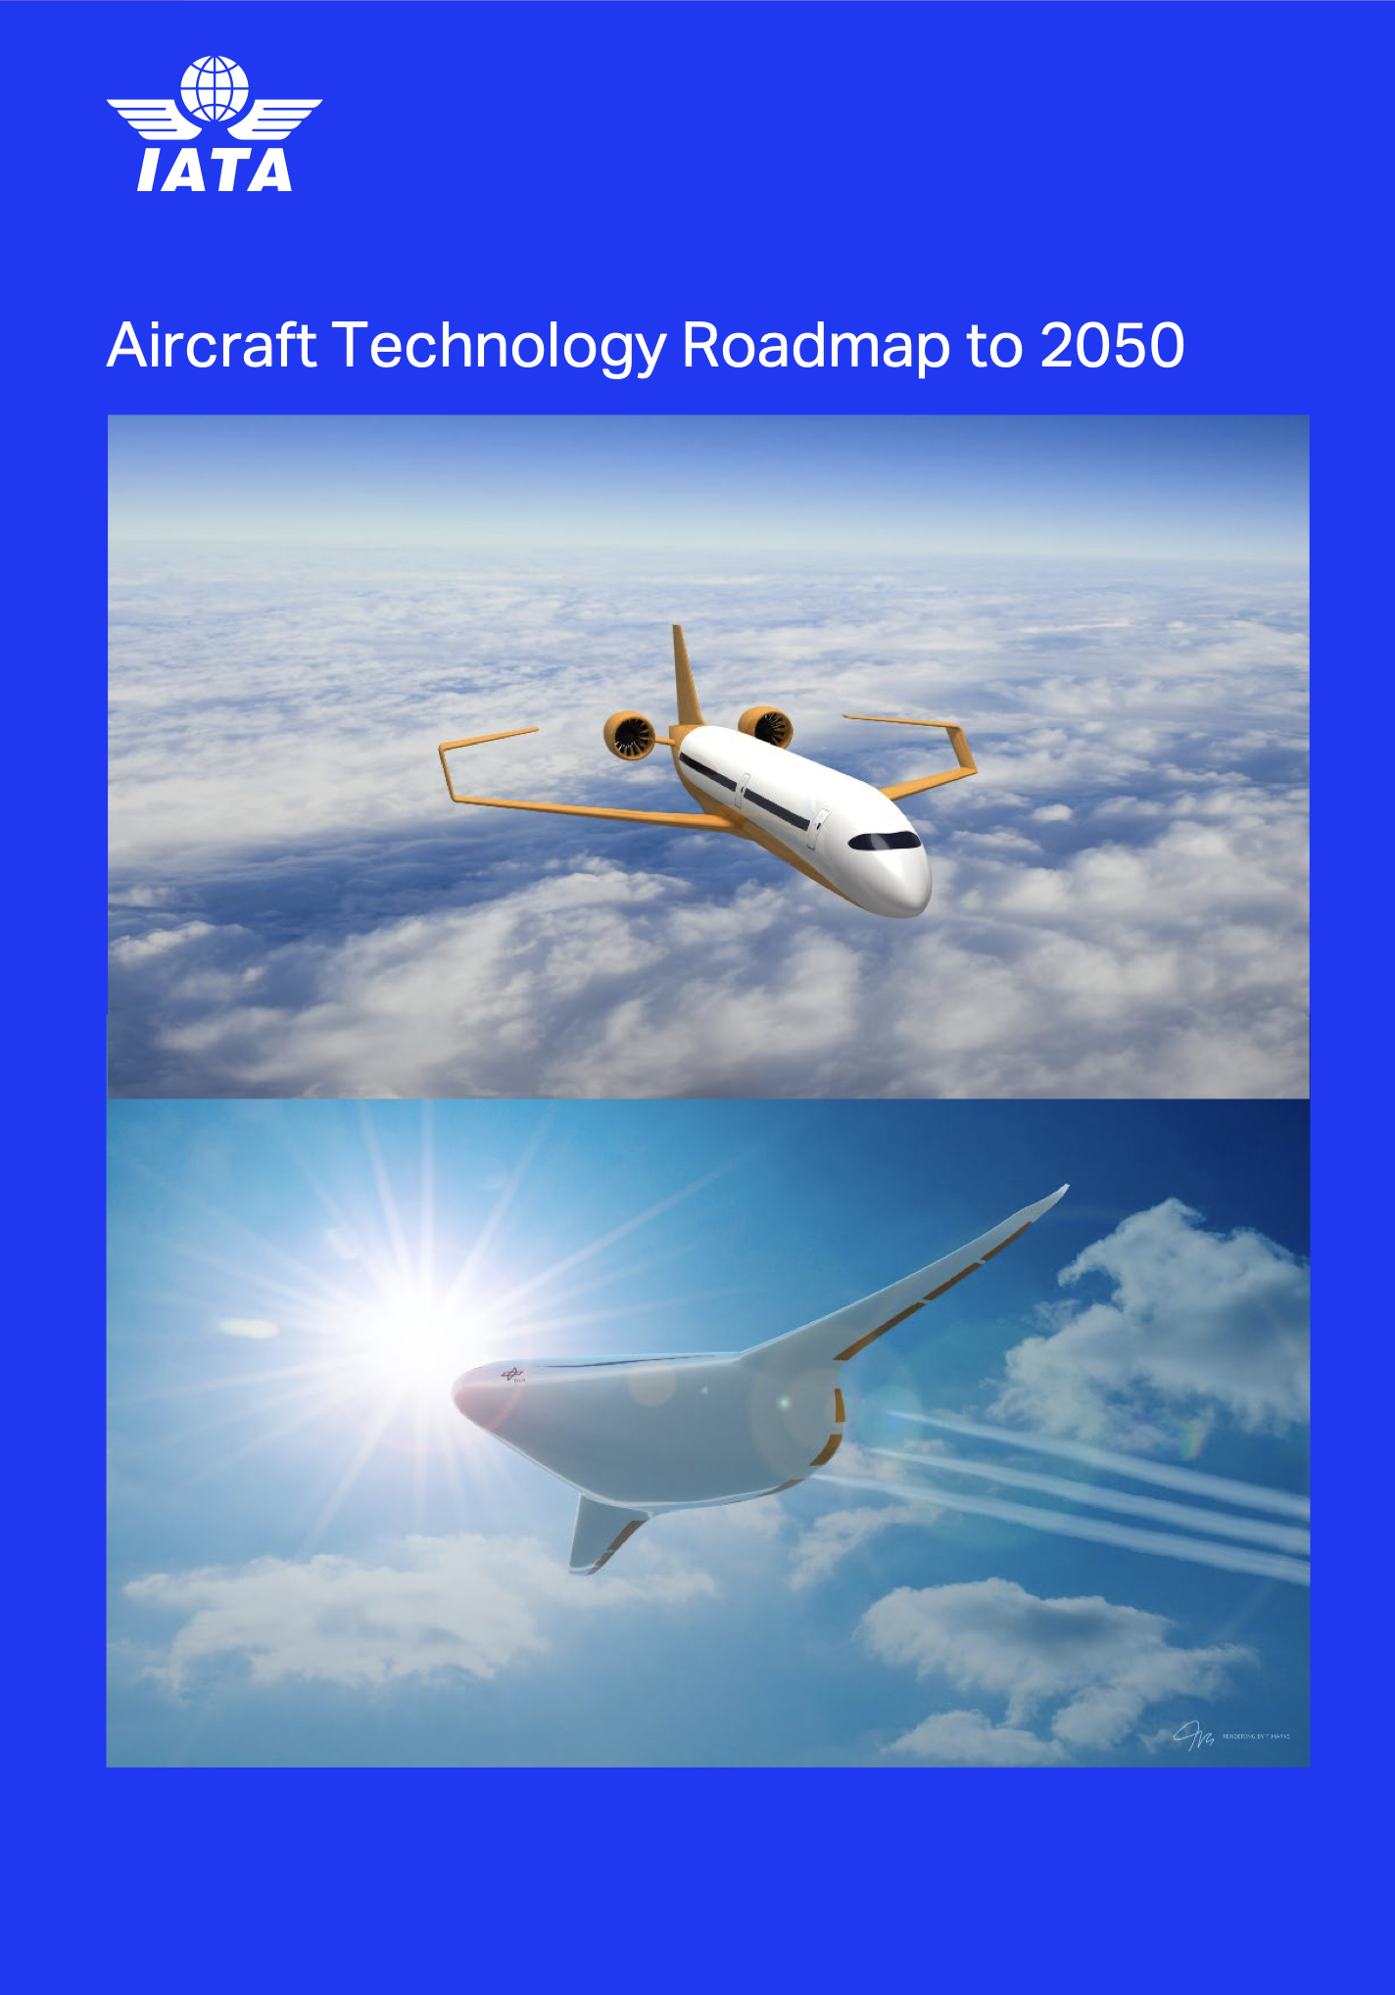

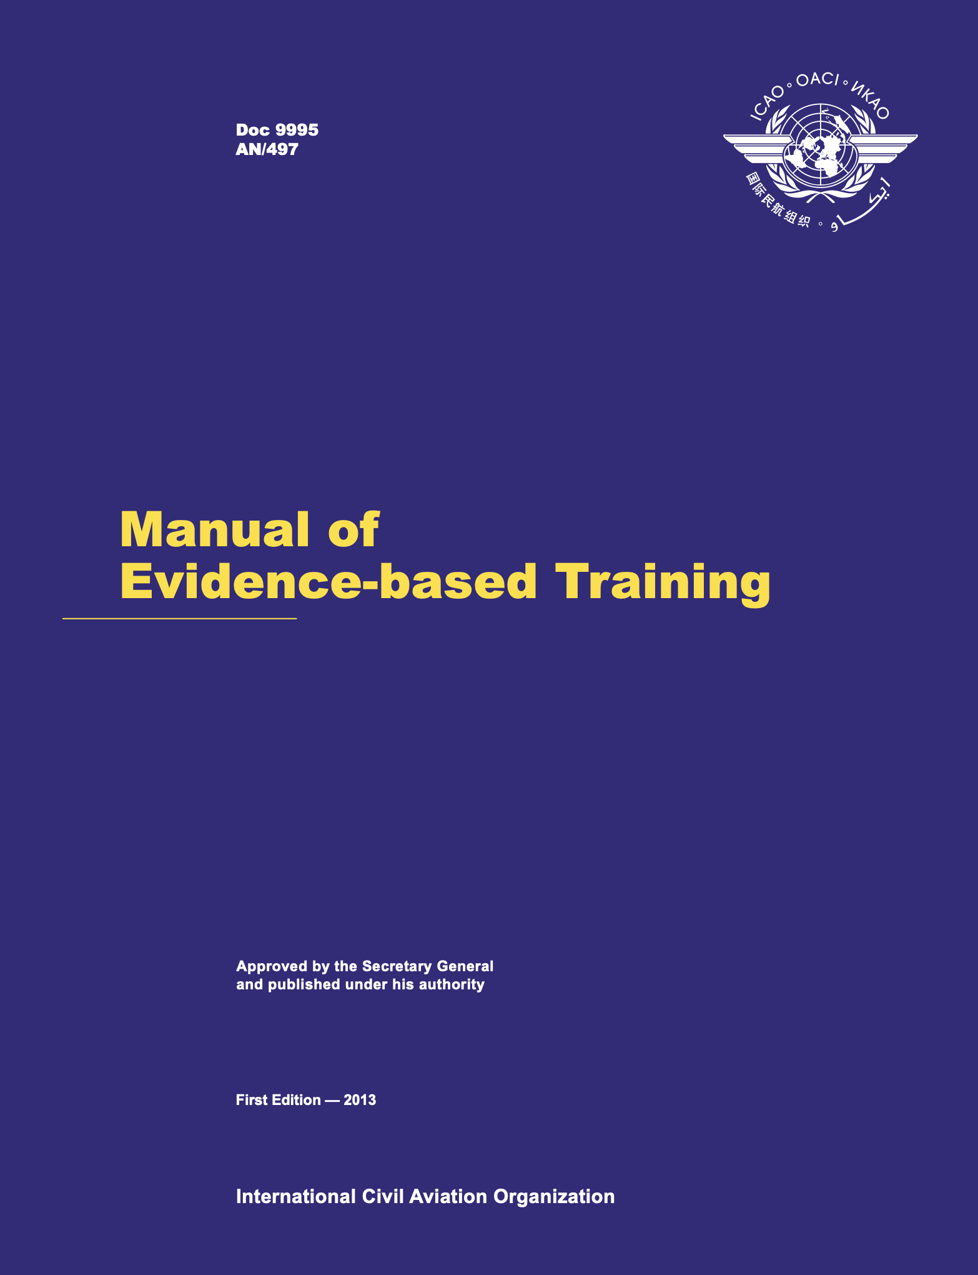

Technology Roadmap in Aviation Industry

Slide 6



Competency-based Training
“Collaborative Engagement with External Partners”
Airline Operational
System
Aviation Education System
"Evidence - driven Continuous improvement”

Slide 7
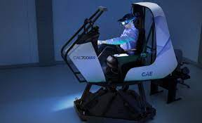
Implementation of Artificial Intelligence in Aviation
A Human-Centric Approach
CBTA competencies | Pilot competencies
PC 0 | Application of Knowledge
PC 1 | Application of Procedures and Compliance with Regulations
PC 2 | Communication
PC 3 | Aeroplane Flight Path Management, automation
PC 4 | Aeroplane Flight Path Management, manual control
PC 5 | Leadership & Teamwork
PC 6 | Problem Solving & Decision Making
PC 7 | Situation Awareness and Management of Information
PC 8 | Workload Management
Human Automation/Autonomy Teaming
Crew Resource Management (CRM) Principles for Remote and Distributed Teams.

Slide 8
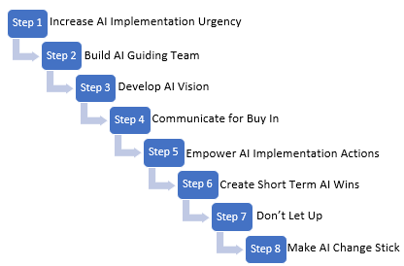
Implementation of Artificial Intelligence in Aviation
A Human-Centric Approach
Adaptive learning and training analytics powered by artificial intelligence (AI).
Training-related behavioral and cognitive methods – Science, Technology, Engineering, and Mathematics,(STEM)
AI training operations optimization
Flight Operations and Closed-loop Flight Training
Independence in Advanced Air Mobility.

Slide 9

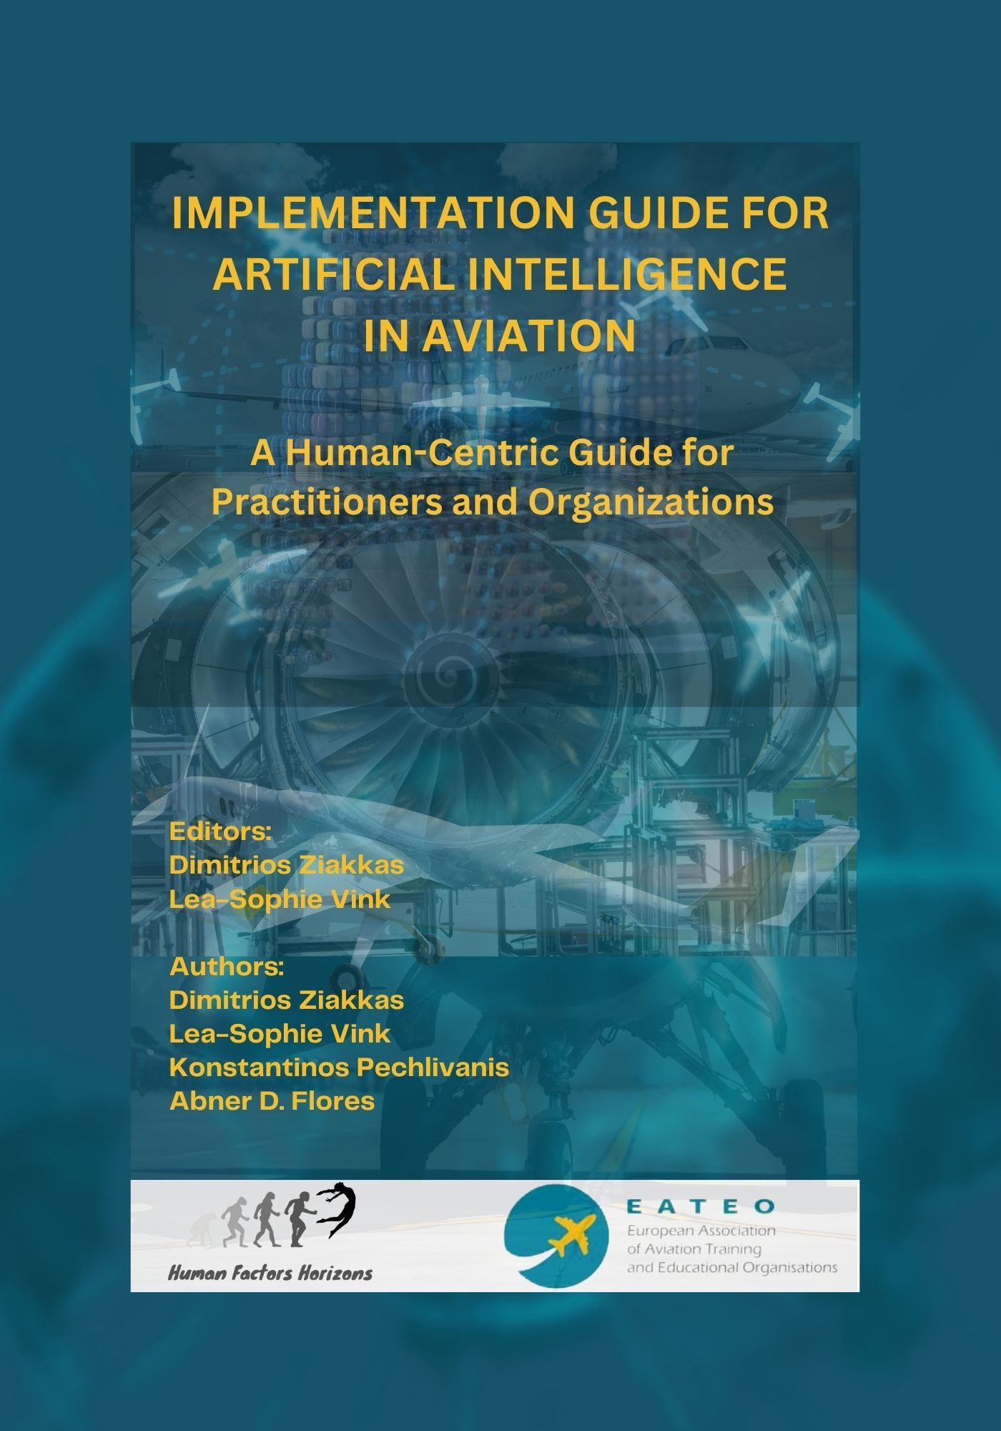
Implementation of Artificial Intelligence in Aviation
A Human-Centric Approach

Slide 10
Implementation of Artificial Intelligence in Aviation
A Human-Centric Approach
Digital Twins in AAM: Design & remote testing prototypes - eVTOL aircraft simulator devices.
HCD in different configurations and scenarios, allowing the research team to identify human factor – certification – training issues and optimize performance (Training – Certification requirements) before the physical prototype is built.
Purdue focus on:
  Human Factors and Ergonomics
  Information Technology
  Operational Domain
  Systems Engineering

Slide 11
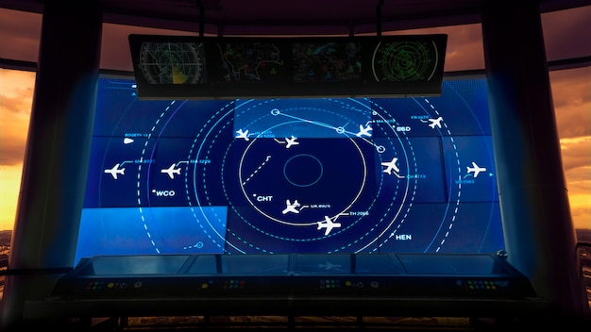
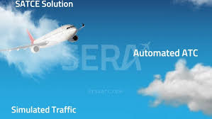

Implementation of Artificial Intelligence in Aviation
A Human-Centric Approach

Slide 12
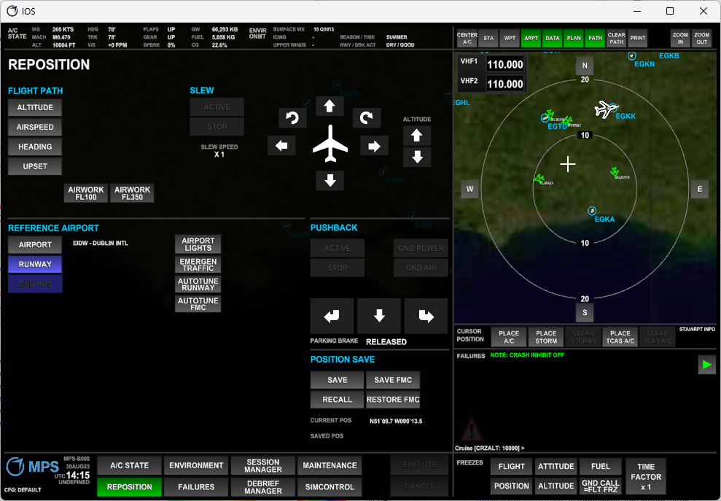
Implementation of Artificial Intelligence in Aviation
A Human-Centric Approach
CBTA competencies | Pilot competencies
PC 0 | Application of Knowledge
PC 1 | Application of Procedures and Compliance with Regulations
PC 2 | Communication
PC 3 | Aeroplane Flight Path Management, automation
PC 4 | Aeroplane Flight Path Management, manual control
PC 5 | Leadership & Teamwork
PC 6 | Problem Solving & Decision Making
PC 7 | Situation Awareness and Management of Information
PC 8 | Workload Management

Slide 13

Implementation of Artificial Intelligence in Aviation
A Human-Centric Approach
Dr. Dimitrios Ziakkas
Assistant Professor

Slide 14


Implementation of Artificial Intelligence in Aviation
A Human-Centric Approach
Dr. Dimitrios Ziakkas
Assistant Professor

